Slide 1
GAME Y – MS PAINT VERSION
HIN018 – Nguyễn Văn Dũng

Slide 2
CONTENT
INTRODUCTION
GAMEPLAY

Slide 3
INTRODUCTION
Early concept:
A endless shooter game
Multiple playable characters with different skills
Can earn power-ups during game
Characters based on a popular daed game – DOTA2 (GAME Y)

Slide 4
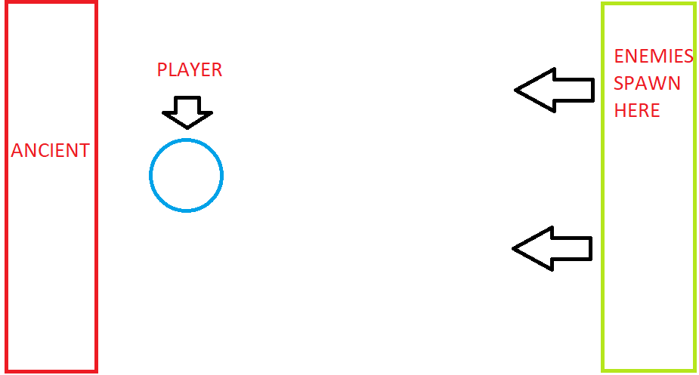
GAMEPLAY
Base defense / shooter game:
Enemies come in waves to attack the Ancient (base)
Player controls character, shoots enemies to defend the Ancient
Score: number of waves defended

Slide 5
GAMEPLAY
Ancient
The main objective
Has HP, decreases if an enemy reaches
Game ends when Ancient has 0 HP

Slide 6
GAMEPLAY
Player
Can choose between different characters
Shoots projectiles (arrows/bullets) to kill enemies Projectiles only go right
8-way movement, can move freely inside the playfield
Each character has a unique ability, can be use after a cooldown timer

Slide 7
GAMEPLAY
Enemies
Multiple types
Come in waves, difficulty increases after each wave (increased movement speed, quantity, etc.)

Slide 8
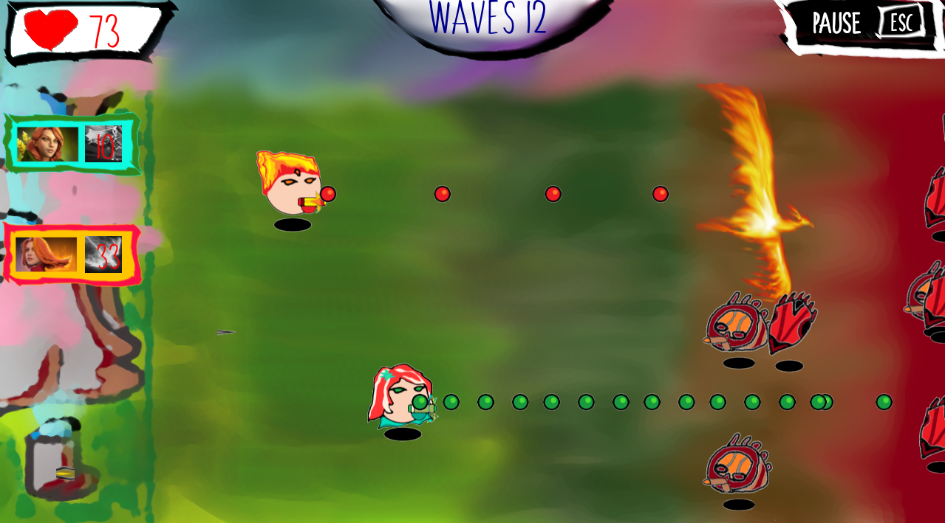
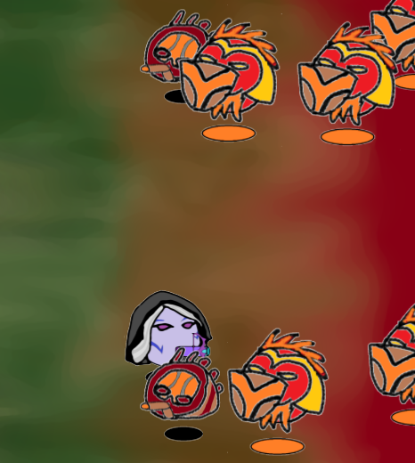
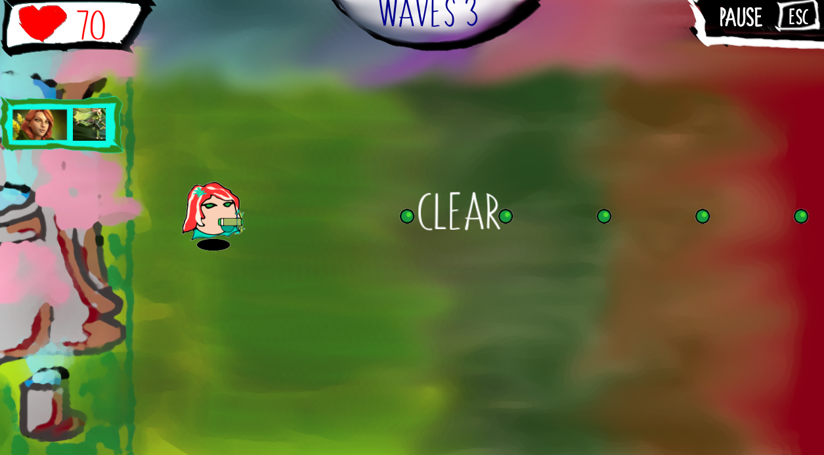
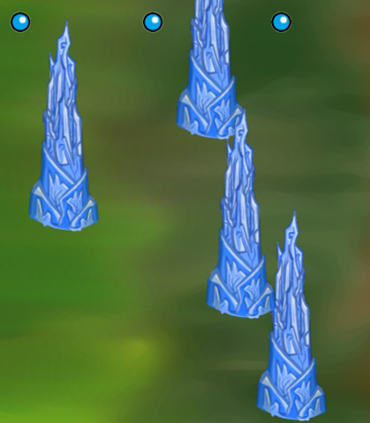
PICTURES

